Slide 1
Introduction to ARM V7
By:
21PC23 - RENUKASHREE
21PC39 - VISHNUPRIYA

Slide 2
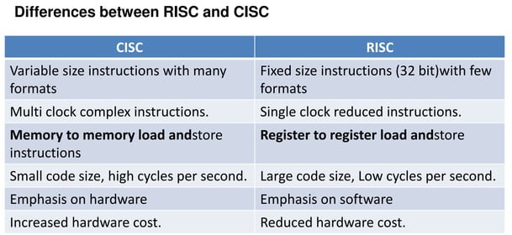

Slide 3
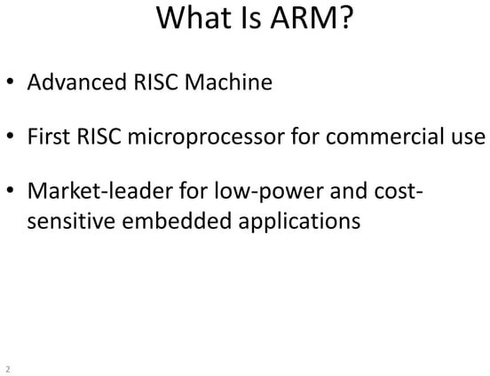

Slide 4
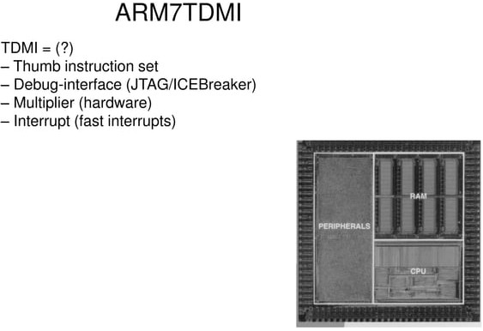

Slide 5
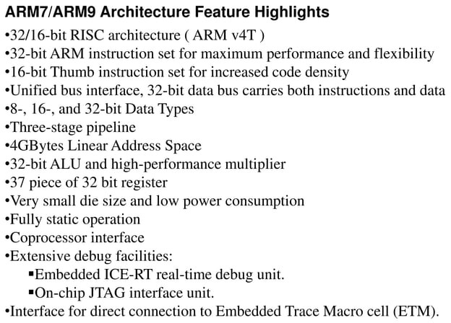

Slide 6
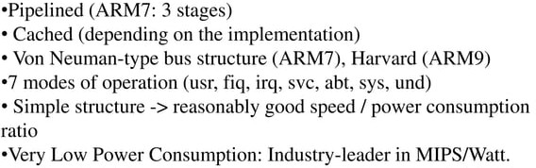

Slide 7


Slide 8
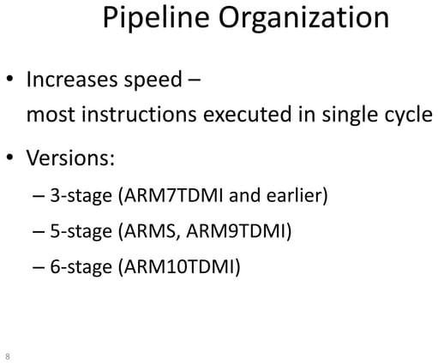

Slide 9
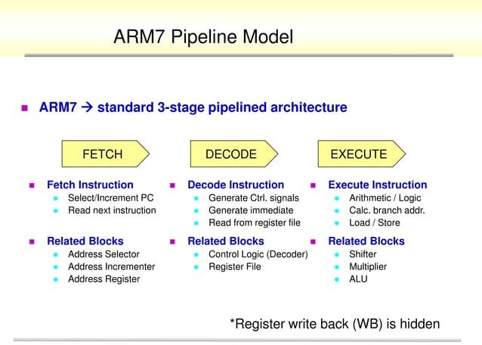

Slide 10
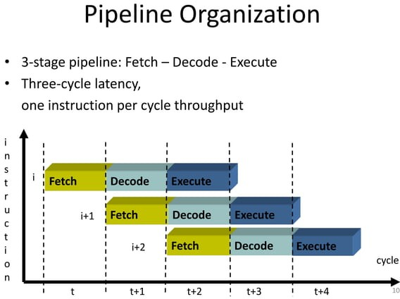

Slide 11
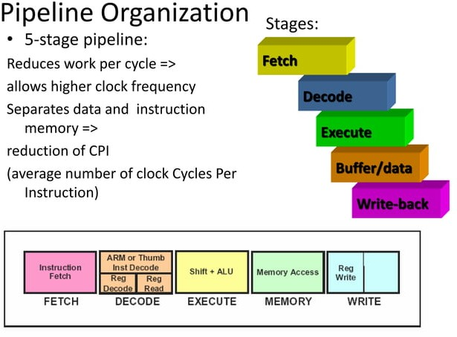

Slide 12
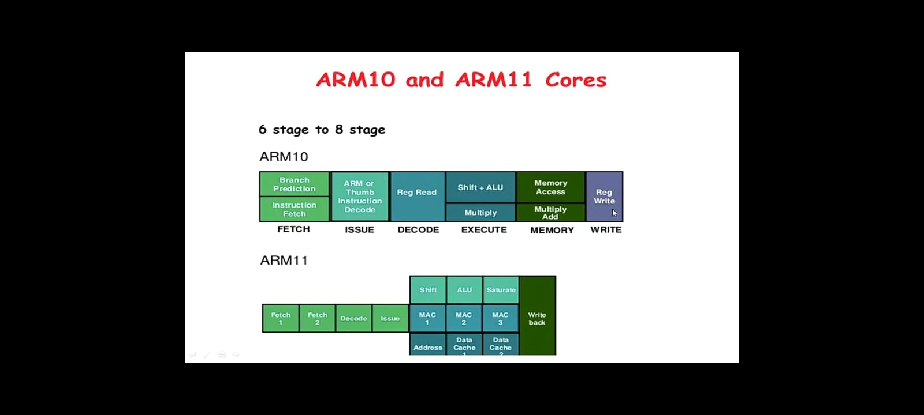

Slide 13
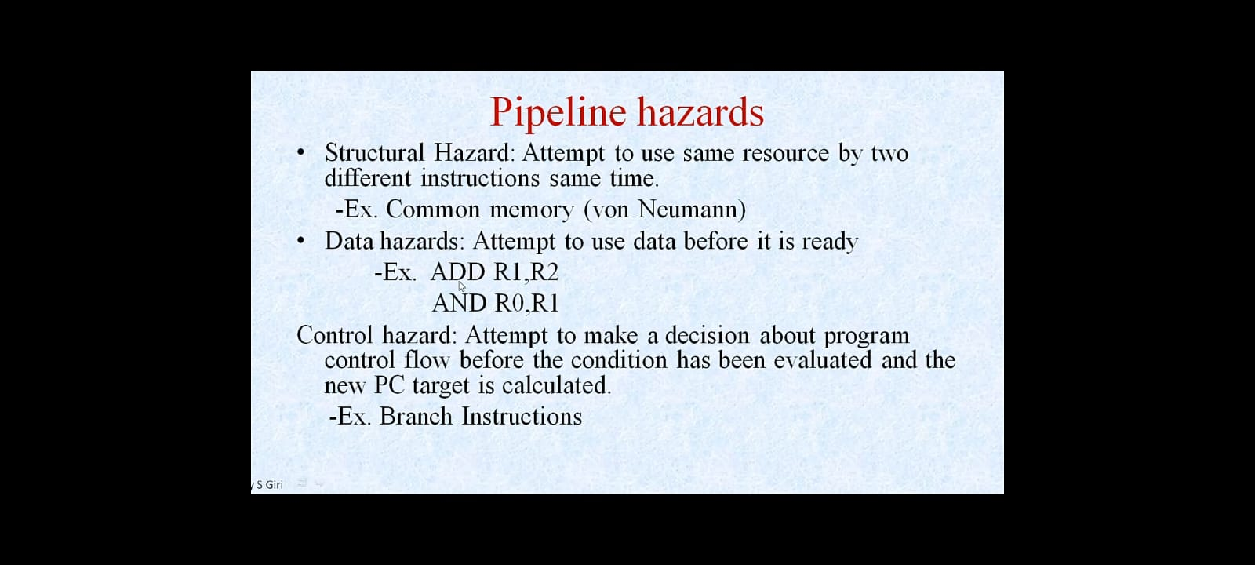

Slide 14
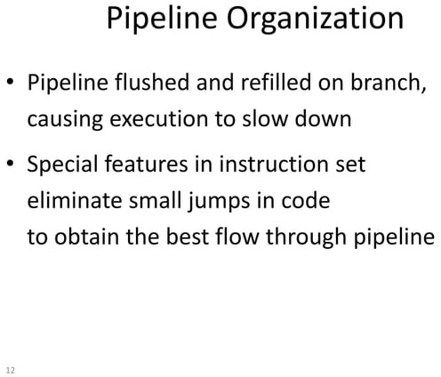

Slide 15


Slide 16
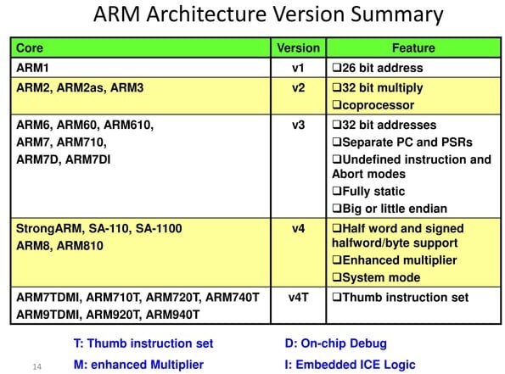

Slide 17
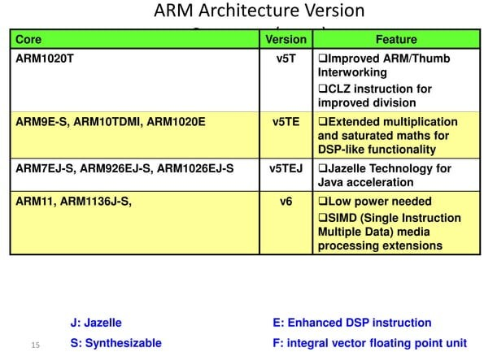

Slide 18
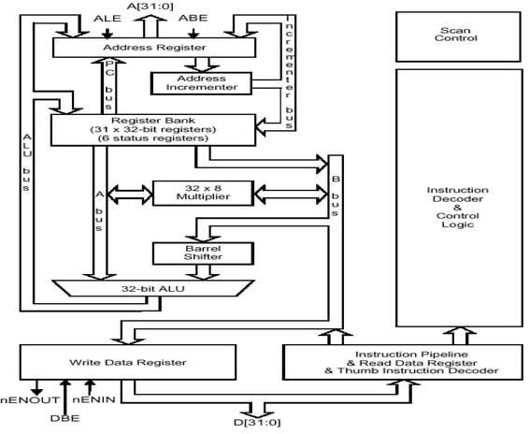

Slide 19
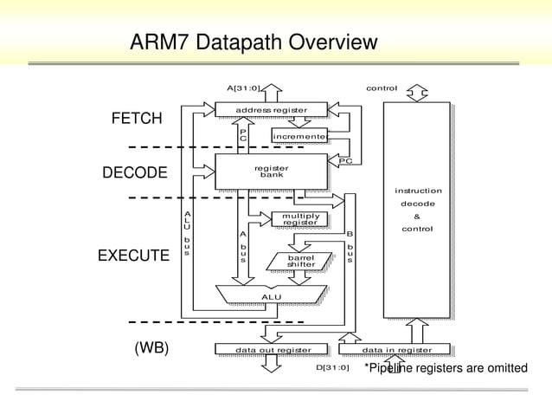

Slide 20
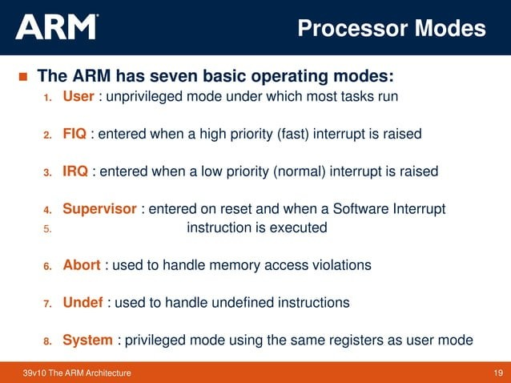

Slide 21
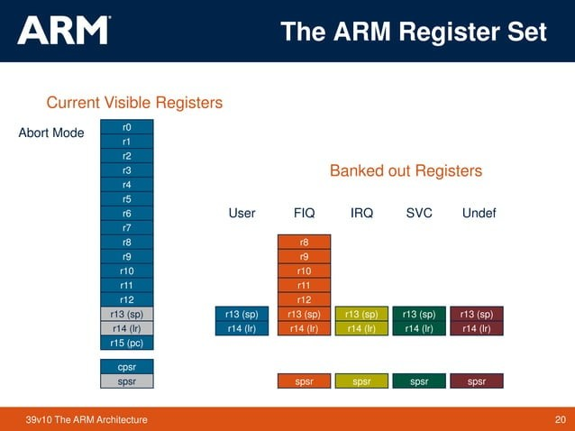

Slide 22
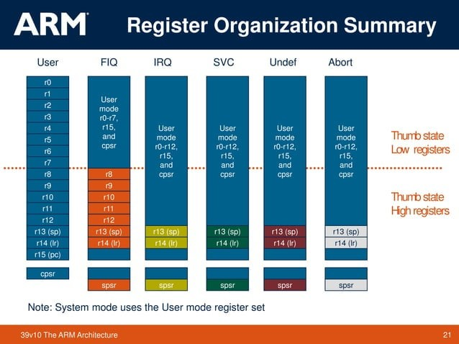

Slide 23
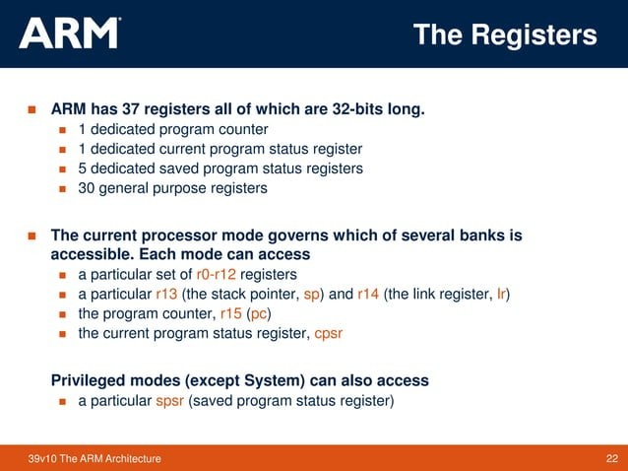

Slide 24
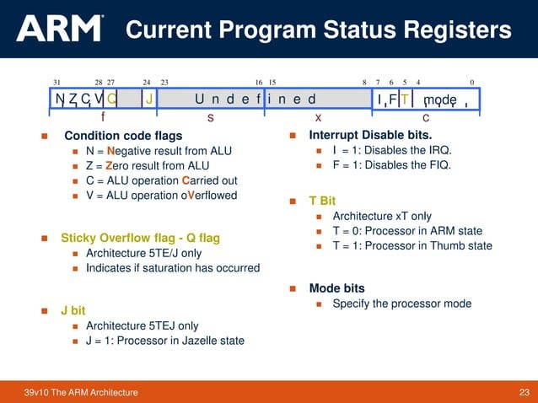

Slide 25
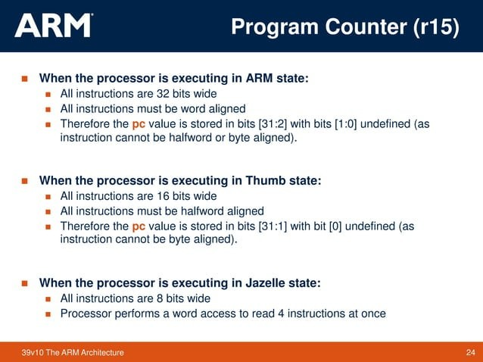

Slide 26
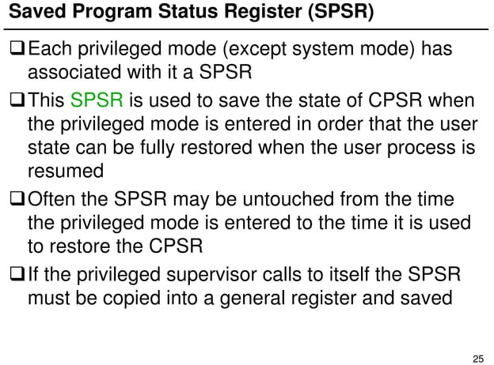

Slide 27
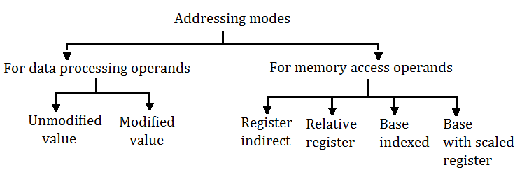
Addressing Modes of ARMV7 Register

Slide 28
Addressing Mode for Data Processing Operand
2 Methods:
Unmodified value In this addressing mode, the register or a value is given unmodified i.e. without any shift or rotation e. g, (i) MOV R0, # 1234 H This instruction will move the immediate constant value 1234 into register R0.
Modified value In this addressing mode, the given value or register is shifted or rotated.
Different shift and rotate operations are possible.

Slide 29
1. Logical Shift: This will take the value of a register and shift the value towards most Significant bits, by n bits, left or right, depending on the instructions.
MOV R0, R1, LSL # 2 --logical left shift operation
MOV R0, R1, LSR #3 --logical right shift operation
2. Arithmetic shift right: This is similar to logical shift right, except that the MSB is retained as well as shifted for arithmetic shift operation e.g. MOV R0, R1, ASR #2
3. Rotate right This will take the value of a register and rotate it right by n bits e.g. MOV R0, R1, ROR R2 After the execution of this instruction R0 will have the value of R1 rotated right for R2 times.
4. Rotate right extended This is similar to Rotate right by one bit, with the carry flag moved into the MSB, i.e. it is similar to rotate right through carry e. g. MOV R0, R1 RRX After the execution of this instruction R0 Will have the value of register R1 rotated right through carry by 1 bit.

Slide 30
Addressing Modes for Memory Access Operand
Register indirect addressing mode: In this addressing mode, a register is used to give the address of the memory location to be accessed.
EG: LDR R0, [R1]
This instruction will load the register R0 with the 32-bit word at the memory address held in the register R1.
(ii) Relative register indirect addressing mode In this addressing mode the memory address is generated by an immediate value added to a register.
Pre index and post index are supported in this addressing mode.

Slide 31
e. g. (a) LDR R0, [R1, #4]
This instruction will load the register R0 with the contents of the memory areas calculated by adding the value 4 to the memory address contained in R1 register
e.g. (b) LDR R0, [R1, #4]!
This is a pre-index addressing. This instruction is same as that in e. g. (a) this instruction also places the new address in R1 i.e R1 (R1 + 4).
e.g. (c)‘LDR R0, [R1], #4
This is post-index addressing. This instruction will load register R0 with the word at memory address given in register R1. It will then calculate the new address by adding 4 to R1 and place this new address in R1

Slide 32
(iii) Base indexed indirect addressing mode
In this addressing mode the , memory address is generated by adding the values of two registers.
Pre-index and post-index are supported also in this addressing mode.
e.g. (a) LDR R0, [R1, R2]
This instruction will load the register R0 with the word at memory address calculated by adding register R1 to register R2.
e.g. (b) LDR R0, [R1, R2]!
This is pre-index addressing. This instruction is same as that in e.g. (a). This instruction also places the new address in R1 i. e. R1 (-R1 + R2.
e.g. (c) LDR R0, [R1], R2
This is a post-index addressing. This instruction will load register R0 with the word at memory address given in register R1. It will then calculate the new address by adding the value in register R2 to register R1 and Place this new address in R1.

Slide 33
iv) Base with scaled register addressing mode
In this addressing mode the memory address is generated by a register value added to another register shifted left.
e.g. (a) LDR R0, [R1, R2, LSL #2]
This instruction will load the register R0 with the word at the memory address calculated by adding register R2 shifted left by 2 bits.
e.g. (b) LDR RO,[R1, R2,_LSL #2]!
This is a pre-indexed addressing. This instruction will load the register R0 with the word at the memory address calculated by adding register R1 with register R2 shifted left by 2 bits.
i.e.R1e-R1+R2 <<2.

Slide 34
e.g. (c) LDR R0, [R1], R2, LSL #2.
This is a post-indexed addressing. This instruction will load the register R0 with the word at memory address contained in register R1. It will then calculate the new address by adding register R1 with register R2 shifted left by two bits. The new address is placed in register.

Slide 35
Thank You!!

